Slide 1




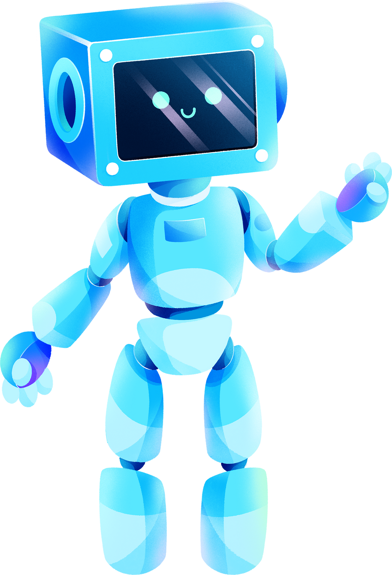
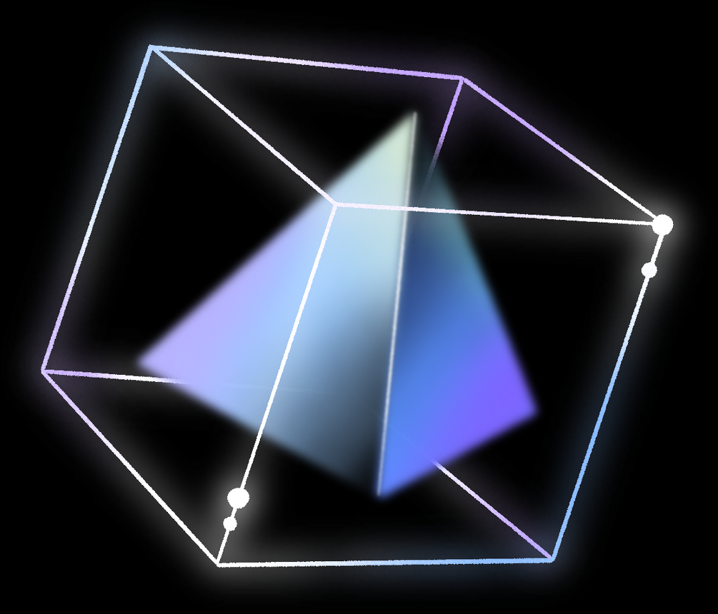
BY-Arnav bhatia 02114811622 tanmay Bansal 02214811622 Aiml-2nd year Submited to – ms gunjAN CHUGH
ARTIFICIAL INTELLIGENCE
PROJECT

Slide 2
TABLE OF CONTENTS
Introduction
Statement about the problem
why is the particular topic chosen
Project Objectives & Scope
Methodology
Hardware and software
Outputs
01
02
03
04
05
06
07

Slide 3

INTRODUCTION
In the contemporary landscape of digital technology, the integration of intelligent and user-centric systems has become paramount to enhance the efficiency and ease of human-computer interactions. Desktop assistants, also known as virtual assistants, represent a significant stride in this direction by providing users with a multifunctional and personalized tool right at their fingertips. This project revolves around the development of a sophisticated desktop assistant using the Python programming language, aiming to amalgamate convenience, functionality, and adaptability in a single, cohesive application.

Slide 4
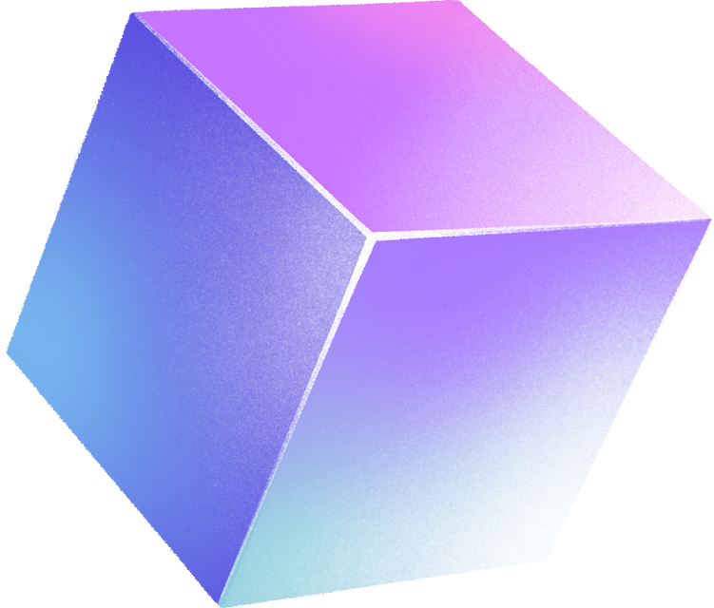
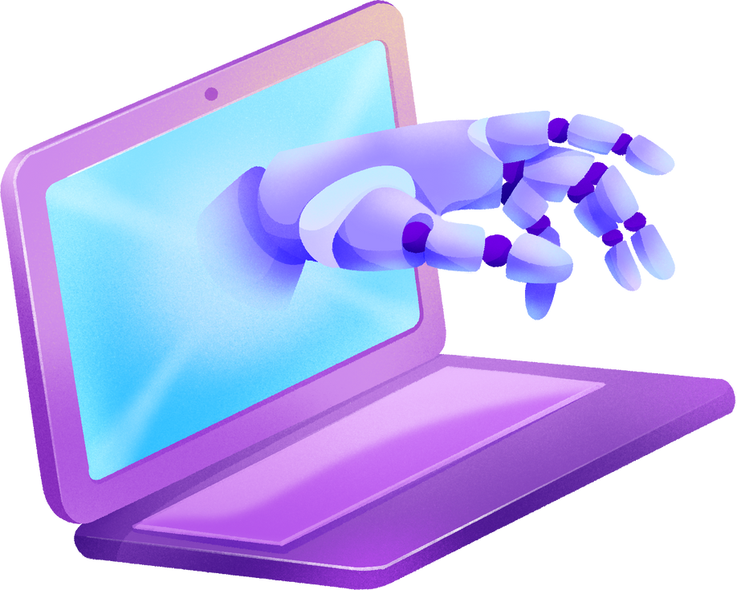
PROBLEM STATEMENT
The contemporary digital landscape is inundated with a myriad of tasks and information, leading to a growing need for an intelligent and context-aware solution to assist users in managing their desktop activities. Traditional desktop interfaces often lack the sophistication required to adapt to user preferences, comprehend natural language commands, and perform a wide array of tasks seamlessly. This inadequacy results in a less optimized and user-friendly computing experience, where users are burdened with the intricacies of navigating through their systems, searching for information, and performing routine actions.The core problem lies in the absence of a centralized and intelligent system that can understand and respond to user commands in a personalized manner. Existing desktop interfaces often require users to manually execute tasks, search for information, and manage applications, leading to a time-consuming and less intuitive interaction model.

Slide 5

KEY CHALLENGES WITH CURRENT DESKTOP
01
02
03
04
Limited Personalization: Traditional desktop interfaces lack the ability to adapt to individual user preferences,1.resulting in a one-size-fits-all approach that may not align with the diverse needs and workflows of users.
Manual Task Execution: Users are often burdened with the manual execution of routine tasks, such as opening applications, searching for files, or setting reminders, leading to a less streamlined and efficient workflow.
Integration of Technologies: Integrating technologies such as speech recognition, NLP, and task automation into a cohesive and user-friendly desktop assistant presents a significant technical challenge.
Complexity of Commands: Users are constrained by the need to remember specific commands and navigate through complex menu structures, hindering the natural and intuitive interaction with the desktop environment.

Slide 6

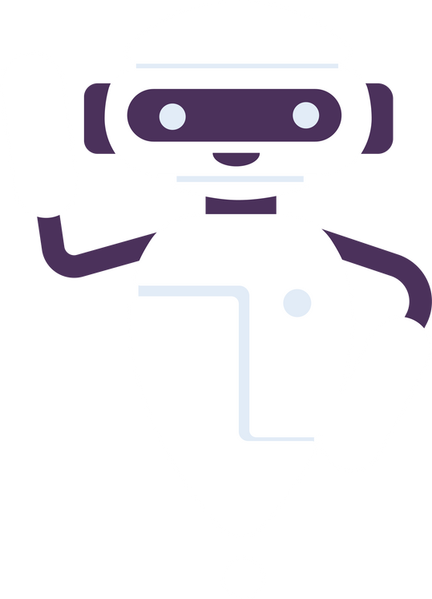

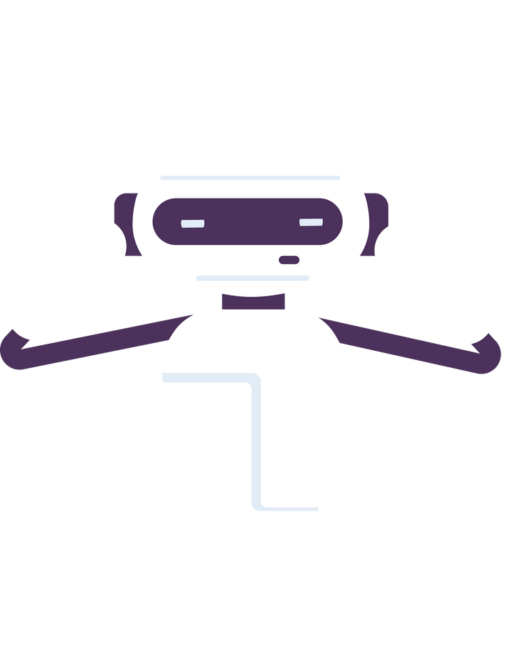



PROJECT OBJECTIVES
OBJECTIVE 01
OBJECTIVE 02
OBJECTIVE 03
Develop a desktop assistant capable of understanding voice and text-based commands
Implement functionalities such as opening applications, searching the web, setting reminders, and providing real-time information.
Design a modular and extensible architecture to enable easy integration of new features.

Slide 7
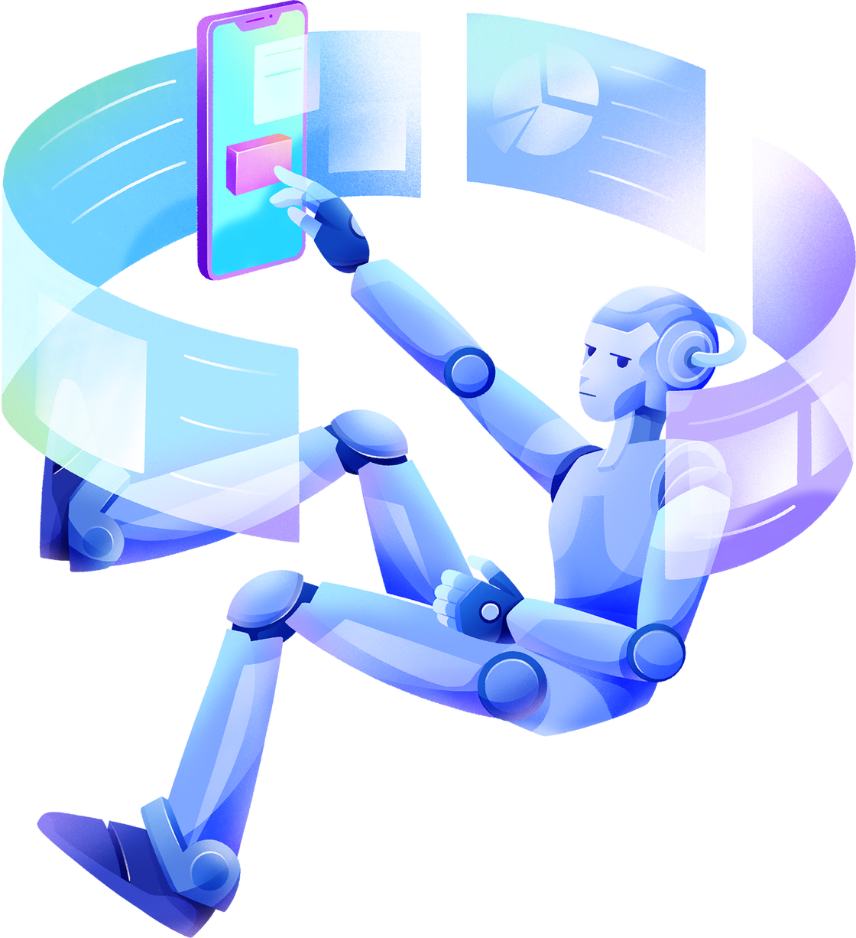

PROJECT SCOPE

Slide 8


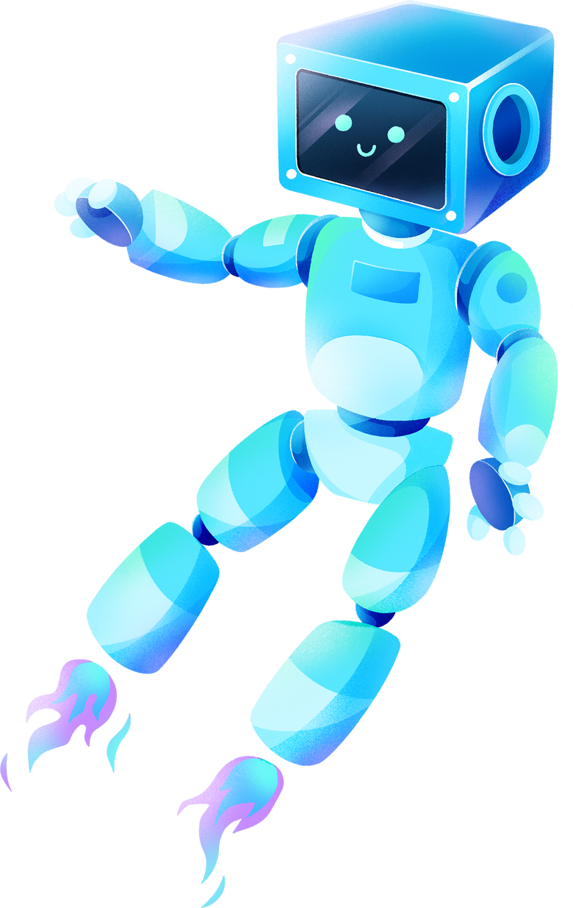



CONTINUOUS LEARNING
INCREASED EFFICIENCY
AUTOMATION
ENHANCED ACCURACY

Slide 9
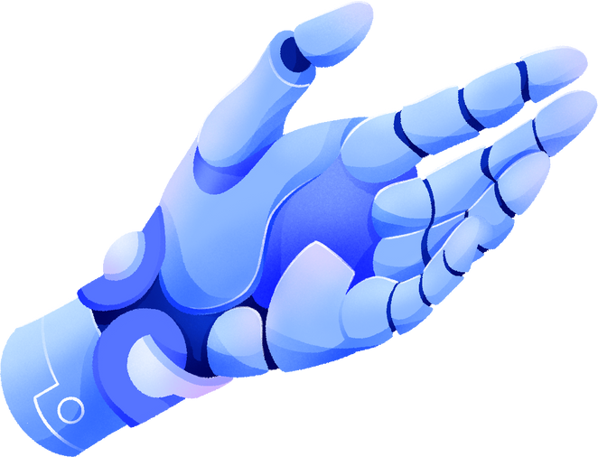
HARDWARE AND SOFTWARE USED
Hardware:
Desktop or Laptop computer running Windows, macOS, or Linux.
Microphone (for voice-based interactions).
Software:
Python programming language.
Speech recognition libraries (e.g., SpeechRecognition)..
Text-to-speech libraries (e.g., pyttsx3).
Integrated Development Environment (IDE) for Python (e.g., VSCode, PyCharm).
Version control system (e.g., Git) for collaborative development.
Use some other basic libraries (eg os, appopener).
.

Slide 10



METHODOLOGY
Deployment: Make the assistant available for use on various desktop platforms.
Requirement Analysis: Identify user needs and functionalities
Implementation: Develop the assistant using Python and relevant libraries.
Maintenance: Provide ongoing support, updates, and improvements based on user feedback.

Slide 11




Libraries used
pyttsx3
speech_recognition
datetime
wikipedia
webbrowser
os
AppOpener
googlesearch
pywhatkit

Slide 12
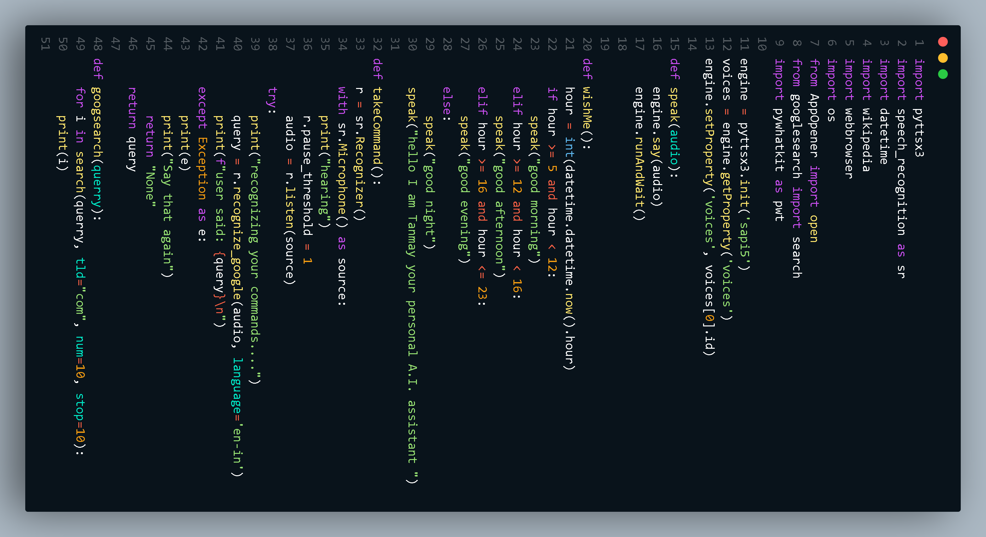

Slide 13
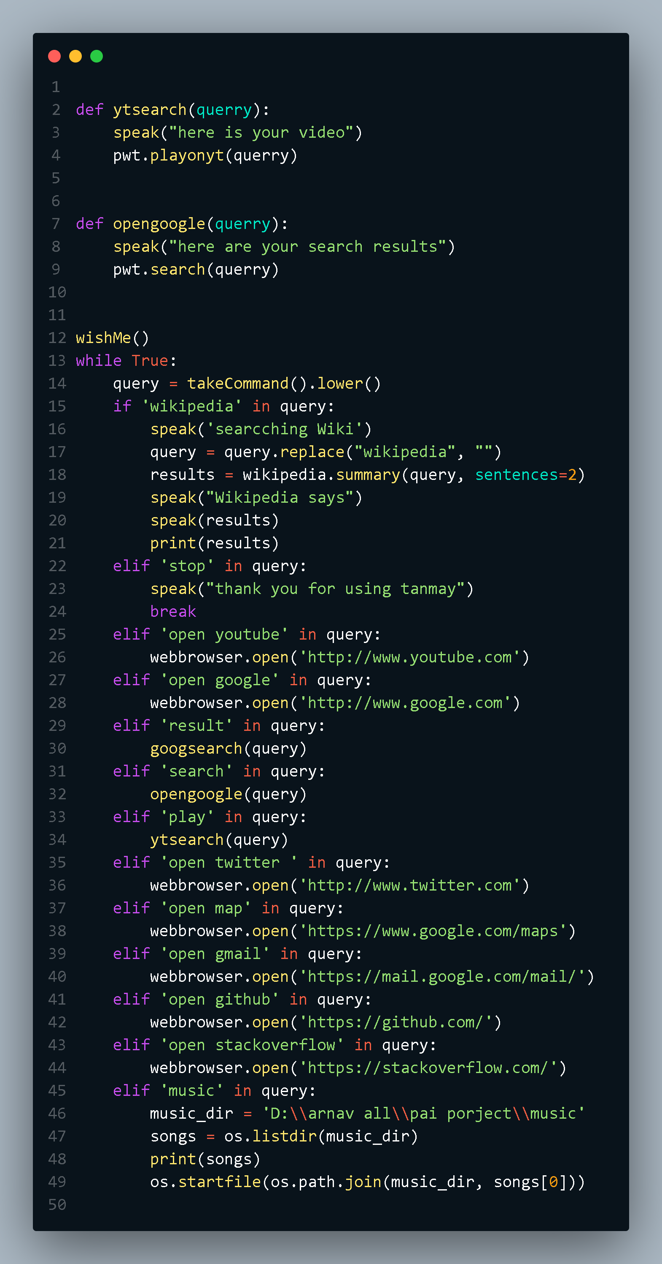

Slide 14
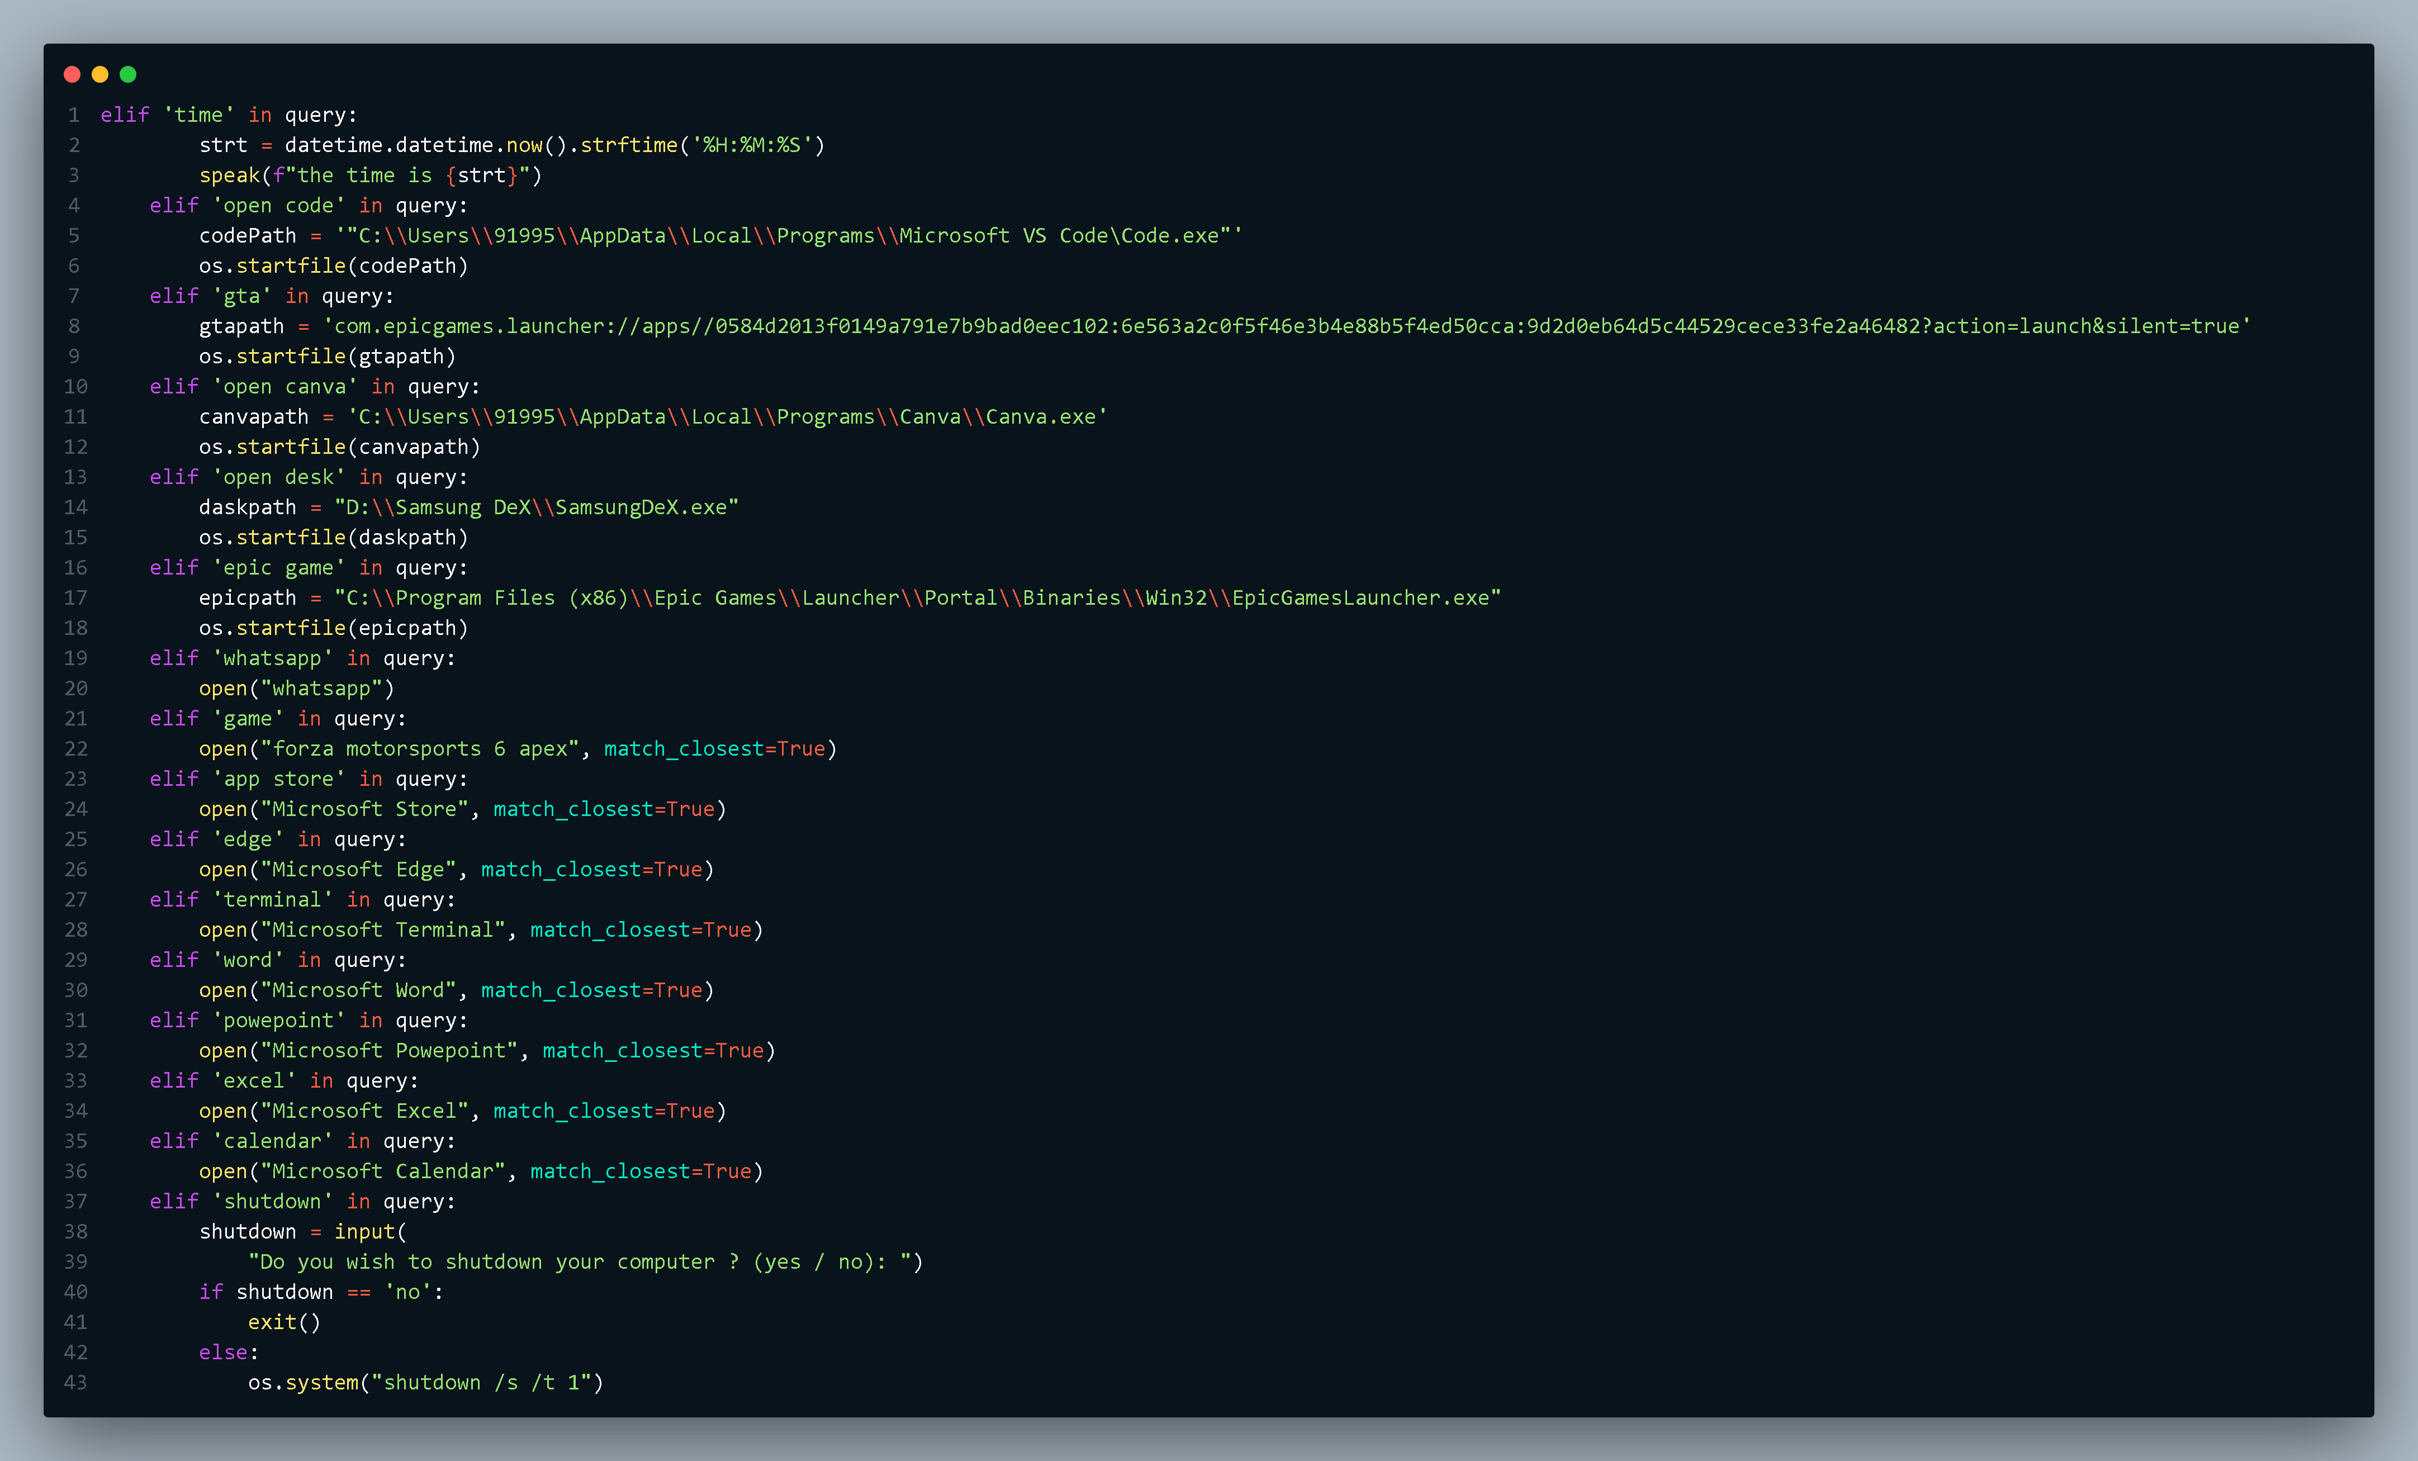

Slide 15
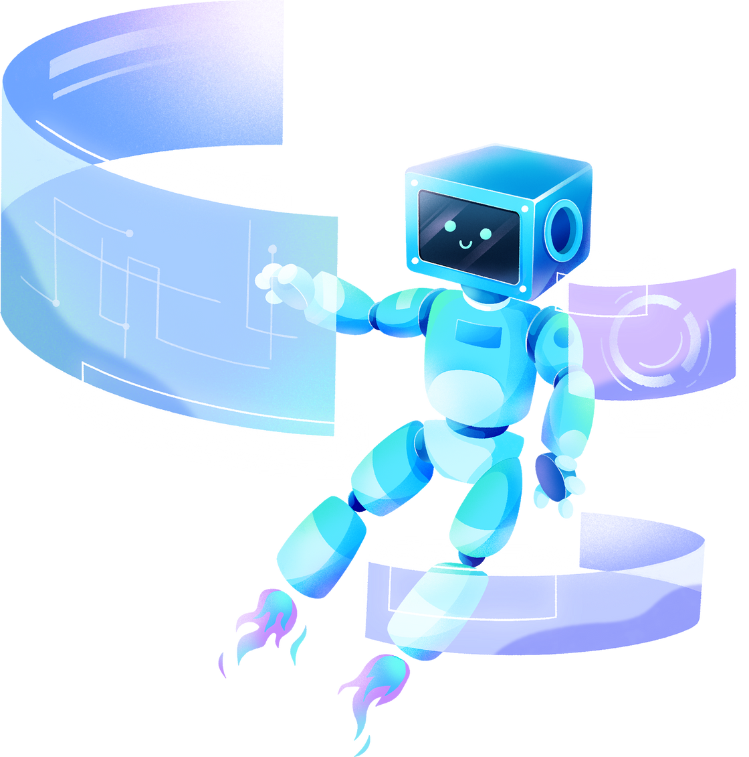
THANK YOU!
ARNAV BHATIA -02114811622
TANMAY BANSAL- 02214811622

